Slide 1

PROJECT QUAKE
Shaking Things Up

Slide 2
Project Team
Participants
Jordan Gilmartin
Lynell Robinson
Min Xie
Nick Mangarella
Sushama Kunnath
Notes:
Jordan

Slide 3
Project Conception
With the ever increasing changes in the climate, we want to take a look at what have been the impacts in nature
We decided to take a look at the impacts through natural disasters, specifically earthquakes
Increasing impacts of earthquakes over time
Notes:
Jordan

Slide 4
Exploration Phase
Some questions we wanted to explore
Has the frequency of earthquakes increase over time?
Has the severity (magnitude) of earthquakes increase over time?
Has the intensity (MMI) of earthquakes increase over time?
Is there a correlation between depth and magnitude?
Is there a correlation between significance and magnitude?
How does this impact the US?
Notes:
Jordan

Slide 5






Exploration Toolset
APIs & Tools
APIs
Tools
Notes:
Lynell

Slide 6
Code Here
Notes:
Lynell

Slide 7
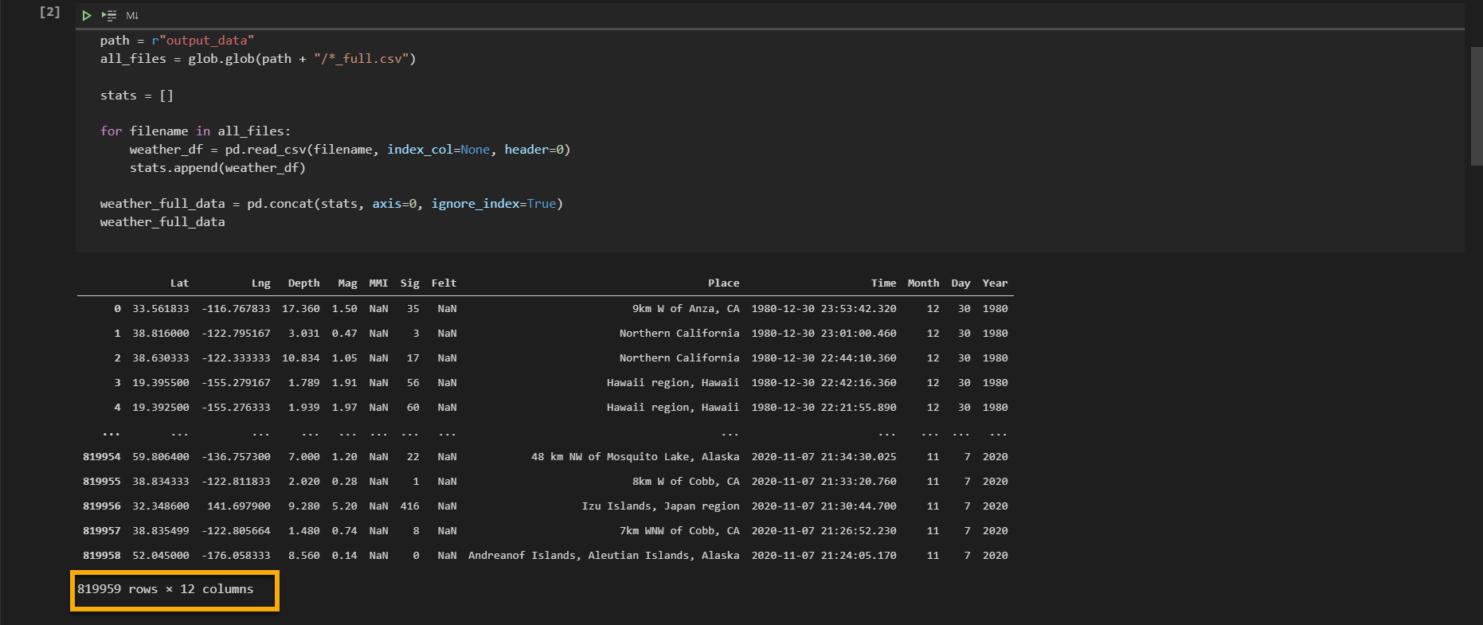
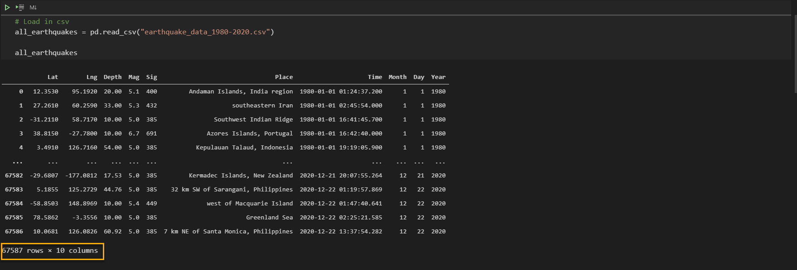
Dataset Cleanup
Narrowing down our data
Pulled over 40 years of earthquake data we discovered:
Too much data to plot
Missing data as we went further back
Reset our focus to earthquakes with large magnitudes
Earthquakes with Magnitude >5
Notes:
Lynell

Slide 8
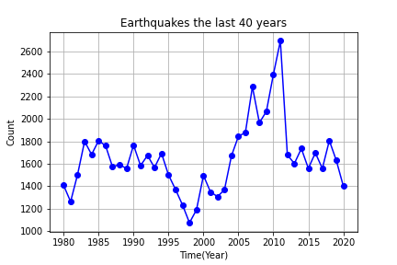
Earthquakes
Earthquakes with >5 magnitudes
The number of earthquakes were consistent
Pattern breaks between early 2000’s
Notes:
Nick

Slide 9
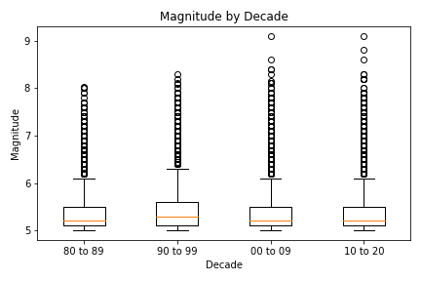
Magnitude
Magnitude by Decade
The past two decades have seen some of the largest earthquakes above 8.0 in magnitude
Notes:
Nick

Slide 10
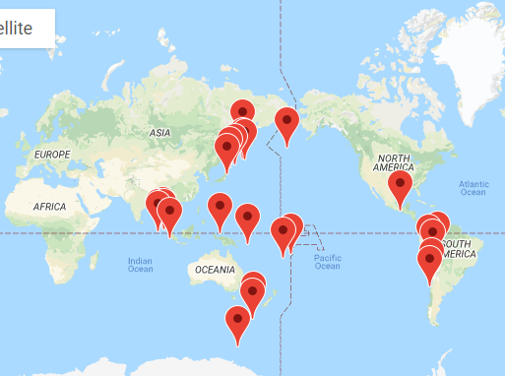
Largest Earthquakes
25 Largest by Magnitude >8
The largest earthquakes occurred mostly off the Asia and South America
Notes:
Nick

Slide 11
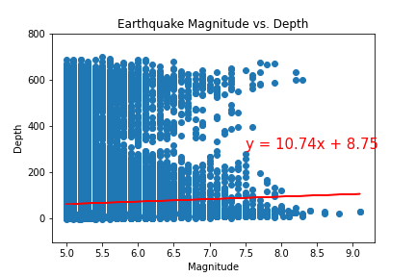
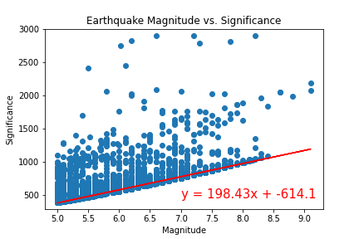
Correlations
Magnitude vs Depth
Magnitude vs Significance
The correlation between Magnitude and Depth is 0.04
The correlation between Magnitude and Significance is 0.85
Notes:
Min

Slide 12
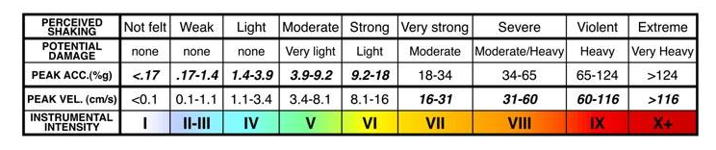
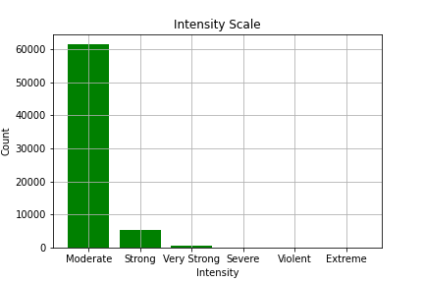
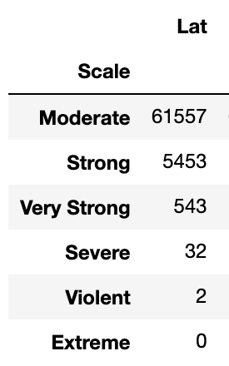
Intensity Scale
Build a scale
Categorized the whole dataset based on intensity
Mag 5 to 5.99: Moderate
Mag 6 to 6.99: Strong
Mag 7 to 7.99: Very Strong
Mag 8 to 8.99: Severe
Mag 9 to 9.99: Violent
Mag 10 and above: Extreme
Notes:
Min

Slide 13
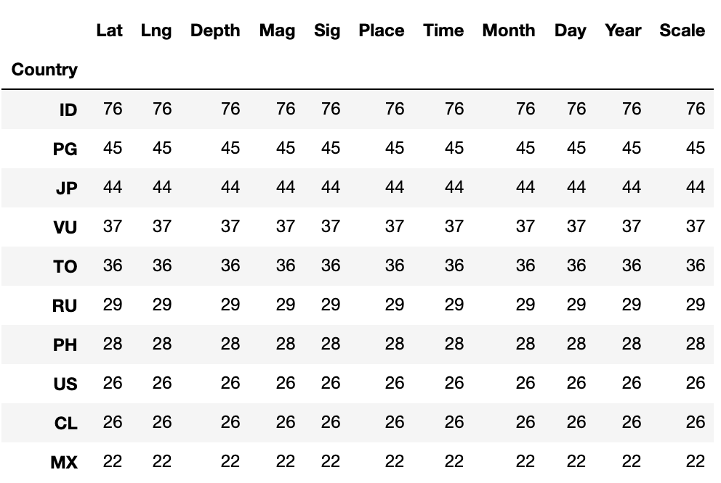
Top 10 Countries
Earthquakes with >7 magnitudes
Look at countries with magnitudes above 7 to determine the top 10 most hit countries.
US is in the top 10, ranked No. 8, with 26 times of earthquakes above mag 7
Notes:
Min

Slide 14
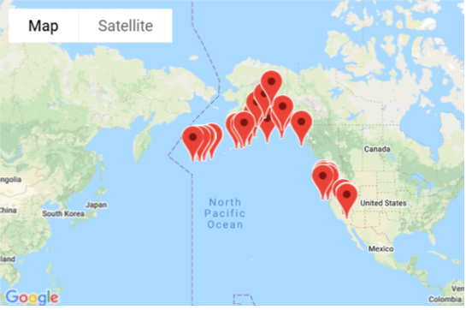
Earthquakes US
Map the Earthquakes
Most of the Earthquakes in the US fall on the West Coast
Notes:
Sushama

Slide 15
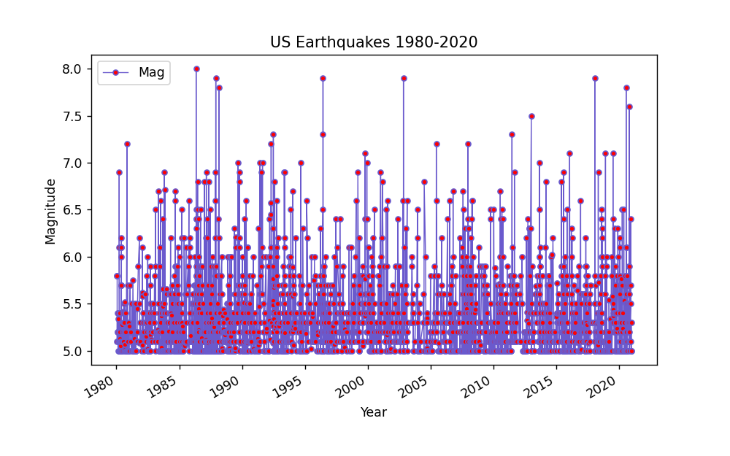
Earthquakes US
Magnitude the Earthquakes
Most of the Earthquakes in the US fall on the West Coast
Notes:
Sushama

Slide 16
Summary
Conclusion
We were not able to plot the total earthquake frequency over time due to the limitation of data (mag >=5), however, we did not observe the severity of earthquakes increasing over time
Pacific plate’s movement (e.g. subducting, spreading, slipping or colliding) seems to be the cause of the most severe earthquakes
The earthquake magnitude is correlated with significance but not the depth
Most earthquakes in US occur at the west coast, probably because that’s where the north American plate meet the pacific plate
Notes:
Sushama

Slide 17
Questions
?

